Slide 1
Recurrent Neural Networks
Hopfield Networks

Slide 2
Network Topology
Feedforward
Feedback
Inputs
Outputs
Inputs
Outputs

Slide 3
Differences In Networks
Feedforward Networks
Solutions are known
Weights are learned
Evolves in the weight space
Used for:
  Prediction
  Classification
  Function approximation
Feedback Networks
Solutions are unknown
Weights are prescribed
Evolves in the state space
Used for:
  Constraint satisfaction
  Optimization
  Feature matching

Slide 4

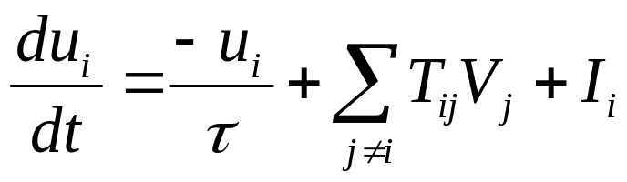
Hopfield Network Neuron Function
One Neuron’s Connections
T_{ij}
u_{i}
I_{i}
V_{i}

Slide 5
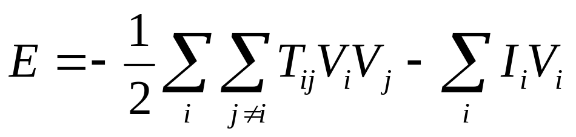
Key Equations
Dynamical System
Energy (Lyapunov) Function

Slide 6
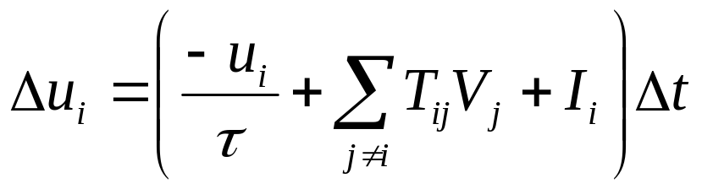
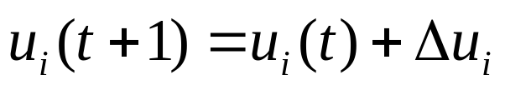
Key Equations (Continued)
Difference Equation
Integration by Newton’s Method

Slide 7
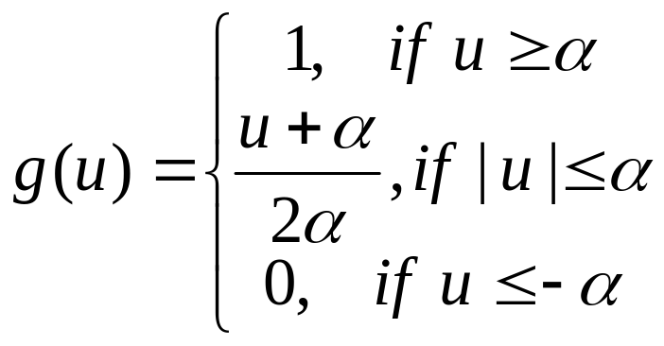
Key Equations (Continued)
Neuron Activation (Response) Function
−α
α

Slide 8
Key Design Concept
If the statement of a problem can be mapped onto the Hopfield “Energy” function, then solutions to the problem can be found at the local minima of the corresponding dynamical system.

Slide 9
Using A Hopfield Network
Formulate the problem so that the state of each neuron represents a binary hypothesis
Represent problem specific data in either I_{i} or T_{ij} (or both)
Place neurons in a random initial state
Evolve network state to an equilibrium
Interpret the state as a solution to the problem

Slide 10
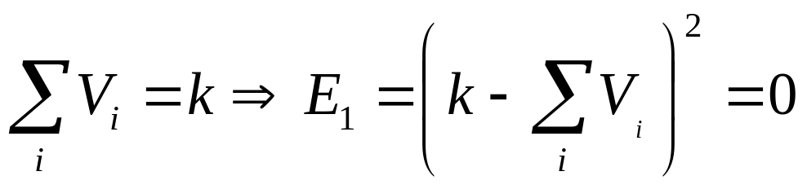
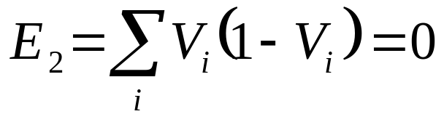
Example: Select K From A Set of N
Problem: Select 6 from a set of 14
One main goal in two sub-goals: Minimize E = E₁ + E₂

Slide 11
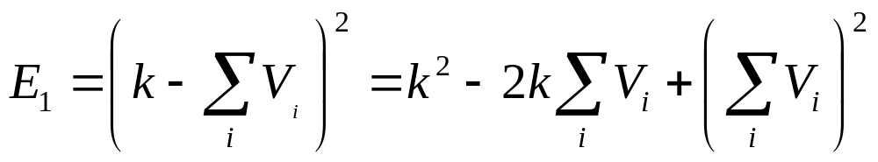
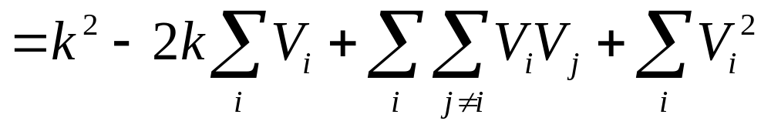
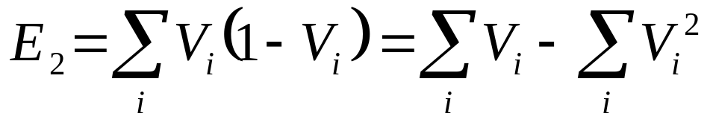
Some Algebra

Slide 12
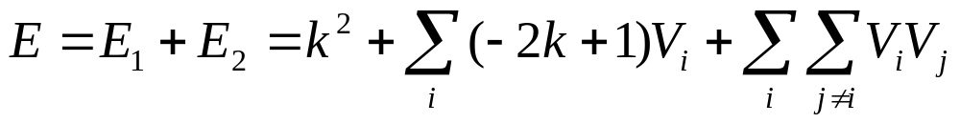
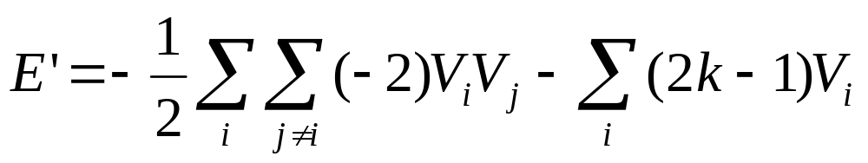
Collecting Similar Terms

Slide 13
Example: Select K From A Set of N
Problem: Select 6 from a set of 14
I_{i} = 2 k – 1 = 11
Mutual inhibition = T_{ij} = -2

Slide 14
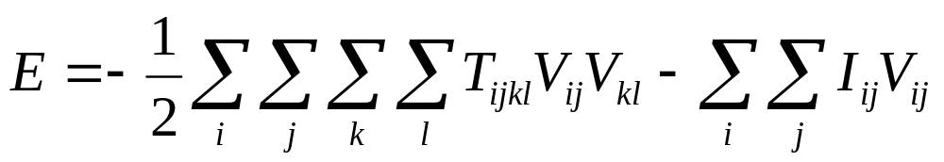
Two-Dimensional Version Of The Energy Equation
Recall the one-dimensional energy equation
To create the two-dimensional energy equation

Slide 15
Example: Make A Good Work Assignment
Suppose n workers are to perform n jobs
Suppose r_{ij} is the rate at which worker i does job j
Find an optimal assignment of workers to jobs
Work Rates
 | Job 1 | Job 2 | Job 3 | Job 4
Art | 5 | 2 | 3 | 1
Bob | 9 | 4 | 6 | 2
Cal | 3 | 4 | 2 | 5
Dan | 3 | 5 | 7 | 7

Slide 16
Example: Make A Good Work Assignment
Jobs
 | Job 1 | Job 2 | Job 3 | Job 4
Art | 5 | 2 | 3 | 1
Bob | 9 | 4 | 6 | 2
Cal | 3 | 4 | 2 | 5
Dan | 3 | 5 | 7 | 7
Personnel

Slide 17
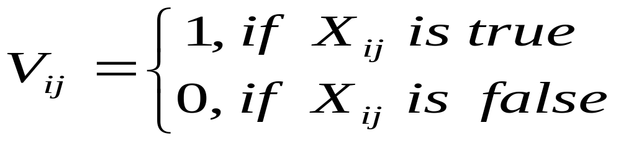
Example: Make A Good Work Assignment (Continued)
Let X_{ij} be the hypothesis that worker i is is assigned task j
Let the neuron output V_{ij} represent the hypothesis X_{ij} as follows:

Slide 18
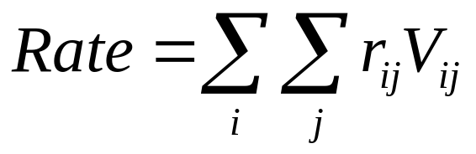
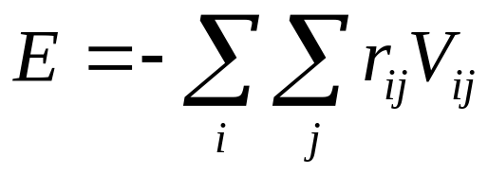
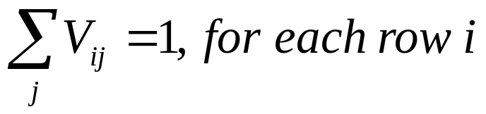
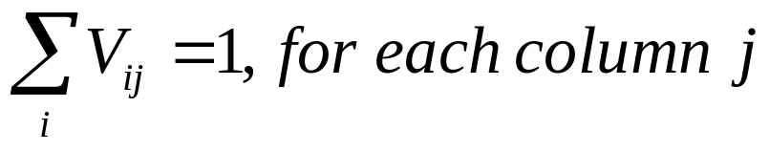
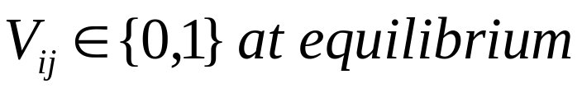
Example: Make A Good Work Assignment (Continued)
Maximize:
Minimize:
Subject to:

Slide 19
Example: Make A Good Work Assignment (Continued)
Jobs
Feedback connections
External inputs
  k=1 per row +
  k=1 per column +
  f(r_{ij})
Personnel

Slide 20
Example: Make A Good Work Assignment (Continued)
T_{ijkl} = -2, if (i,j)!=(k,l) and i=k or j=l and
0, otherwise
I_{ij} = 2 + f(r_{ij}), where f is a monotonic scaling function and |f(x)|<0.5

Slide 21
Example: Make A Good Work Assignment (Continued)
0 | 2 | 2 | 2 | 2 | 0 | 0 | 0 | 2 | 0 | 0 | 0 | 2 | 0 | 0 | 0
2 | 0 | 2 | 2 | 0 | 2 | 0 | 0 | 0 | 2 | 0 | 0 | 0 | 2 | 0 | 0
2 | 2 | 0 | 2 | 0 | 0 | 2 | 0 | 0 | 0 | 2 | 0 | 0 | 0 | 2 | 0
2 | 2 | 2 | 0 | 0 | 0 | 0 | 2 | 0 | 0 | 0 | 2 | 0 | 0 | 0 | 2
2 | 0 | 0 | 0 | 0 | 2 | 2 | 2 | 2 | 0 | 0 | 0 | 2 | 0 | 0 | 0
0 | 2 | 0 | 0 | 2 | 0 | 2 | 2 | 0 | 2 | 0 | 0 | 0 | 2 | 0 | 0
0 | 0 | 2 | 0 | 2 | 2 | 0 | 2 | 0 | 0 | 2 | 0 | 0 | 0 | 2 | 0
0 | 0 | 0 | 2 | 2 | 2 | 2 | 0 | 0 | 0 | 0 | 2 | 0 | 0 | 0 | 2
2 | 0 | 0 | 0 | 2 | 0 | 0 | 0 | 0 | 2 | 2 | 2 | 2 | 0 | 0 | 0
0 | 2 | 0 | 0 | 0 | 2 | 0 | 0 | 2 | 0 | 2 | 2 | 0 | 2 | 0 | 0
0 | 0 | 2 | 0 | 0 | 0 | 2 | 0 | 2 | 2 | 0 | 2 | 0 | 0 | 2 | 0
0 | 0 | 0 | 2 | 0 | 0 | 0 | 2 | 2 | 2 | 2 | 0 | 0 | 0 | 0 | 2
2 | 0 | 0 | 0 | 2 | 0 | 0 | 0 | 2 | 0 | 0 | 0 | 0 | 2 | 2 | 2
0 | 2 | 0 | 0 | 0 | 2 | 0 | 0 | 0 | 2 | 0 | 0 | 2 | 0 | 2 | 2
0 | 0 | 2 | 0 | 0 | 0 | 2 | 0 | 0 | 0 | 2 | 0 | 2 | 2 | 0 | 2
0 | 0 | 0 | 2 | 0 | 0 | 0 | 2 | 0 | 0 | 0 | 2 | 2 | 2 | 2 | 0
T_{ijkl} = -

Slide 22
Example: Weapon-Target-Assignment
Targets
Time
Weapons

Slide 23
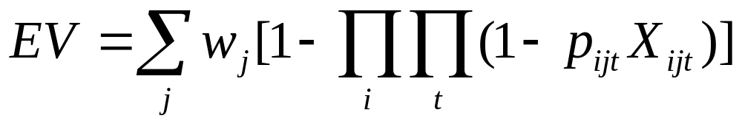
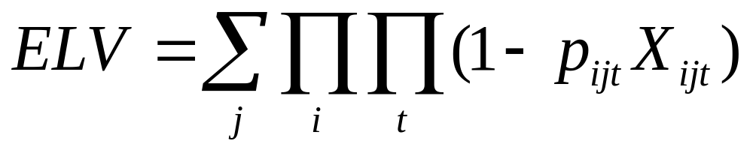
Example: Weapon-Target-Assignment
Maximize:
Minimize:

Slide 24
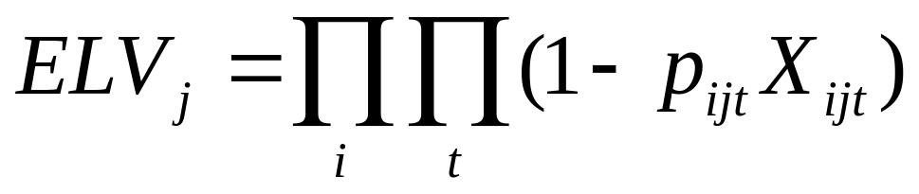
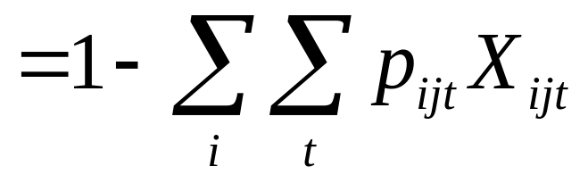
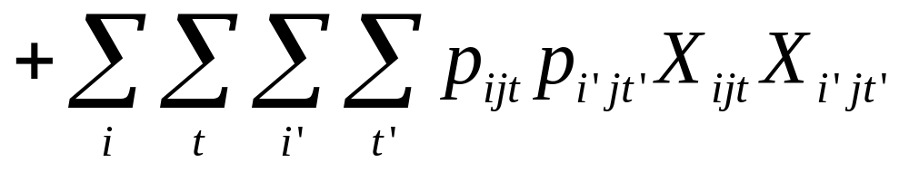
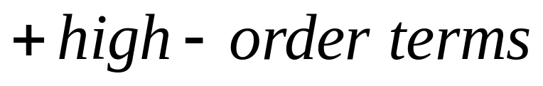
Example: Weapon-Target-Assignment

